Slide 1
WTF is an SVG
Lora Kulm
@loraj_k
lorajk.com

Slide 2
Lora Kulm
@loraj_k
lorajk.com

Slide 3
WTF
@loraj_k

Slide 4
SVG
Scalable Vector Graphic
@loraj_k
Notes:
XML-based vector image format for 2-D graphics with support for interactivity and animation. The SVG specification is an open standard developed by W3C since 1999.

Slide 5
SVG
Scalable Vector Graphic
@loraj_k

Slide 6
SVG
Scalable Vector Graphic
@loraj_k

Slide 7
SVG
Scalable Vector Graphic
@loraj_k

Slide 8
Vector
Raster
Line/curve based
Drawn with paths
Scalable
File size is much smaller
Pixel based
DPI/PPI - pixels per inch
Great for images
More pixels = larger files
@loraj_k

Slide 9
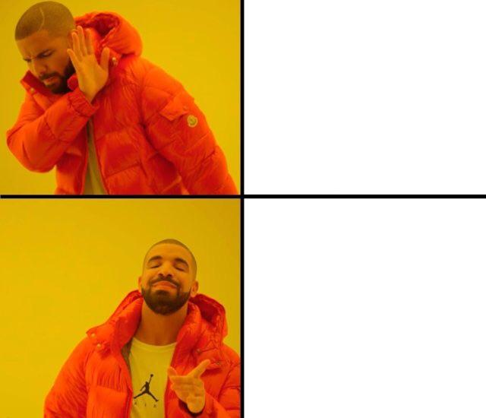


@loraj_k

Slide 10
<path fill="none" stroke="#231F20" stroke-width="20" stroke-linecap="round" stroke-miterlimit="10" d="M74,601h200V475
c0-41.4,33.6-75,75-75h0c41.4,0,75,33.6,75,75v126h200V276L349.5,75.5l-275,200L74,601z"/>
@loraj_k

Slide 11
PATH DATA
@loraj_k

Slide 12
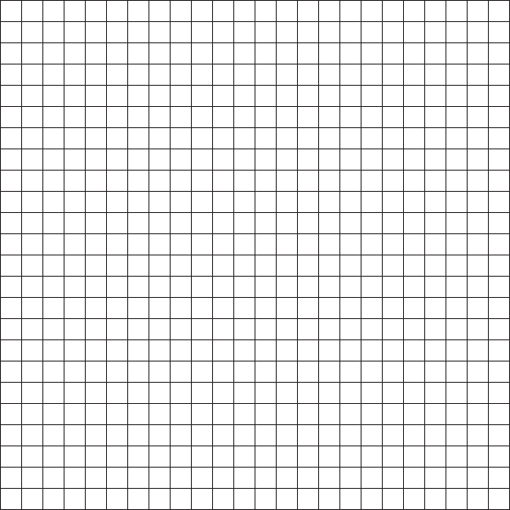
M - Move to
M 1 22
Move to x-coordinate 1, y-coordinate 22
@loraj_k

Slide 13
L - Line to
M 1 22 L 9 22
Draw a line to x-coordinate 9, y-coordinate 22
@loraj_k

Slide 14
H - Horizontal Line
M 1 22 H 9
Draw a horizontal line to x-coordinate 9
@loraj_k
Notes:
Horizontal lines require only one point

Slide 15
L - Line to
M 1 22 L 9 22 L 9 14
@loraj_k

Slide 16
V - Vertical Line
M 1 22 L 9 22 V 14
Draw a vertical line to y-coordinate 14
@loraj_k
Notes:
Vertical lines also only need one point, but for the sake of clarity and preparation for later path data, we’re going to continue to use LINE TO

Slide 17
L - Line to
M 1 22 L 9 22 L 9 14 L 15 14
@loraj_k

Slide 18
L - Line to
M 1 22 L 9 22 L 9 14 L 15 14 L 15 22
@loraj_k

Slide 19
L - Line to
M 1 22 L 9 22 L 9 14 L 15 14 L 15 22 L 23 22
@loraj_k

Slide 20
L - Line to
M 1 22 L 9 22 L 9 14 L 15 14 L 15 22 L 23 22 L 23 9
@loraj_k

Slide 21
L - Line to
M 1 22 L 9 22 L 9 14 L 15 14 L 15 22 L 23 22 L 23 9 L 12 1
@loraj_k

Slide 22
L - Line to
M 1 22 L 9 22 L 9 14 L 15 14 L 15 22 L 23 22 L 23 9 L 12 1 L 1 9
@loraj_k

Slide 23
Z - Close path
M 1 22 L 9 22 L 9 14 L 15 14 L 15 22 L 23 22 L 23 9 L 12 1 Z
End the path at the initial point
@loraj_k

Slide 24
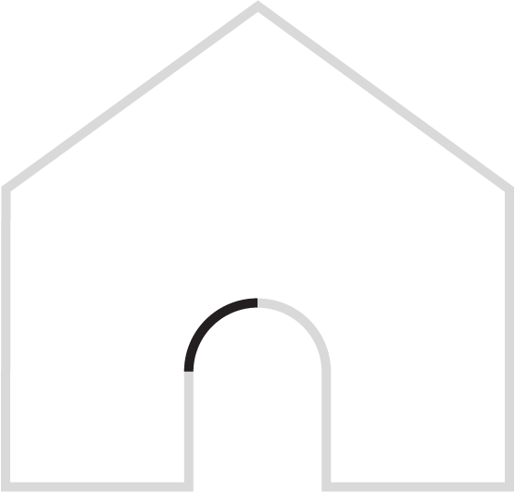
C - Cubic Bezier
M 1 22 L 9 22 L 9 14 C 9 16 11 14 12 14 L 15 14 L 15 22 L 23 22 L 23 9 L 12 1 Z
Curve from 3 sets of points - the two control points and the line end
@loraj_k

Slide 25
C - Cubic Bezier
M 1 22 L 9 22 L 9 14 C 9 16 11 14 12 14 C 12 14 15 16 15 17 L 15 14 L 15 22 L 23 22 L 23 9 L 12 1 Z
@loraj_k

Slide 26
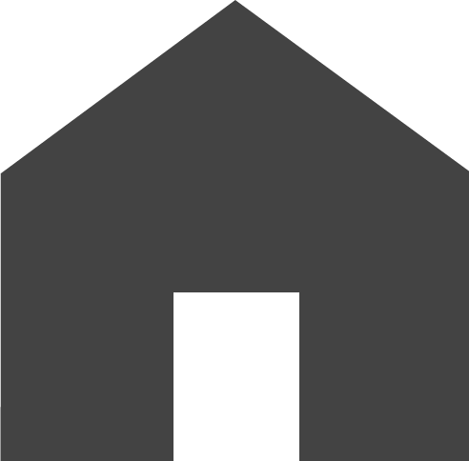
Fill
fill=”#434343”
Fill the path with a particular color
@loraj_k

Slide 27
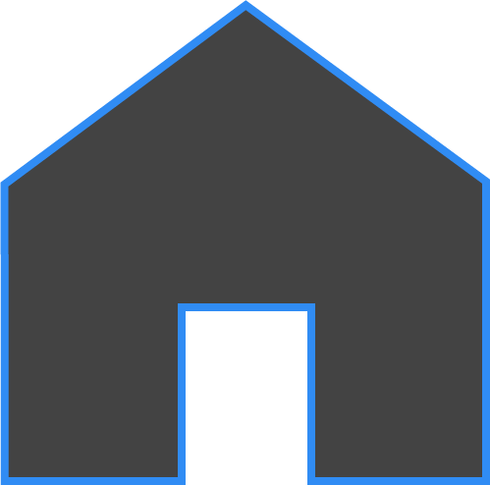
Stroke
stroke=”#308cf4”
Changes the color of the stroke
@loraj_k

Slide 28


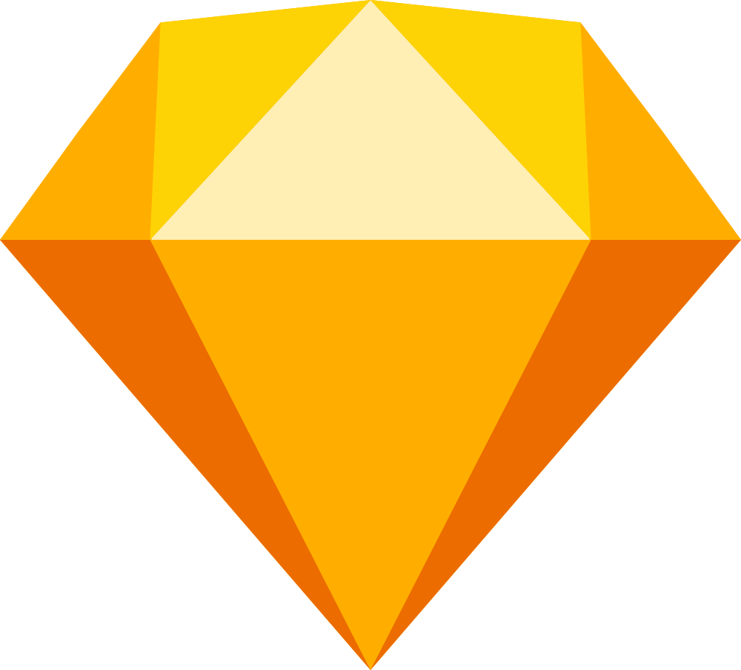
@loraj_k

Slide 29
VectorDrawable ≠ SVG
@loraj_k

Slide 30
Courtesy of Giphy
@loraj_k

Slide 31
This lets you create a drawable based on an XML vector graphic.
https://developer.android.com/reference/android/graphics/drawable/VectorDrawable.html
@loraj_k
Notes:
Introduced in API 21

Slide 32
This lets you create a drawable based on an XML vector graphic.
https://developer.android.com/reference/android/graphics/drawable/VectorDrawable.html
@loraj_k
Notes:
Introduced in API 21

Slide 33
VectorDrawable
XML code that is BASED on SVG
Doesn’t actually read or support SVG format
Draws the SVG on a Canvas using path data from the XML
Also creates a bitmap cache to save redrawing time
@loraj_k

Slide 34
So why should I use it?
@loraj_k

Slide 35
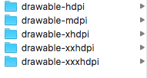
@loraj_k

Slide 36
SCALABLE
@loraj_k

Slide 37
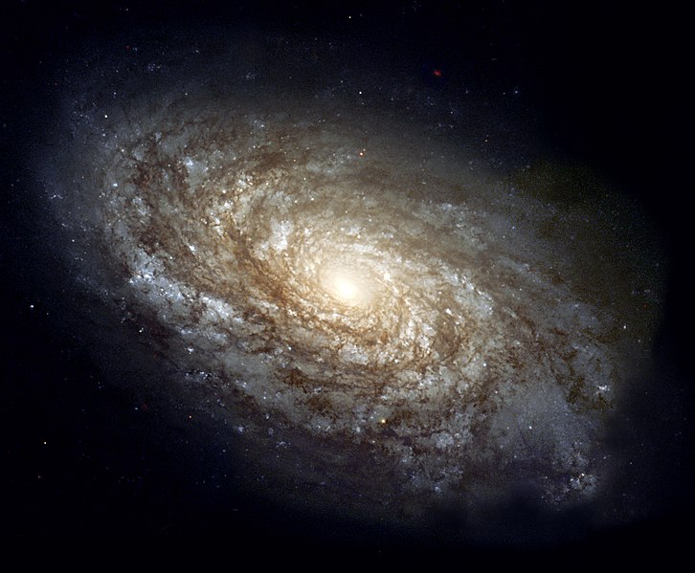
Image courtesy of NASA / Hubble Space Telescope
@loraj_k

Slide 38
SPACE
Image courtesy of NASA / Hubble Space Telescope
@loraj_k

Slide 39
Courtesy of Giphy
@loraj_k

Slide 40
ANIMATION
Courtesy of Giphy
@loraj_k

Slide 41
So how do I make a VectorDrawable?
@loraj_k

Slide 42
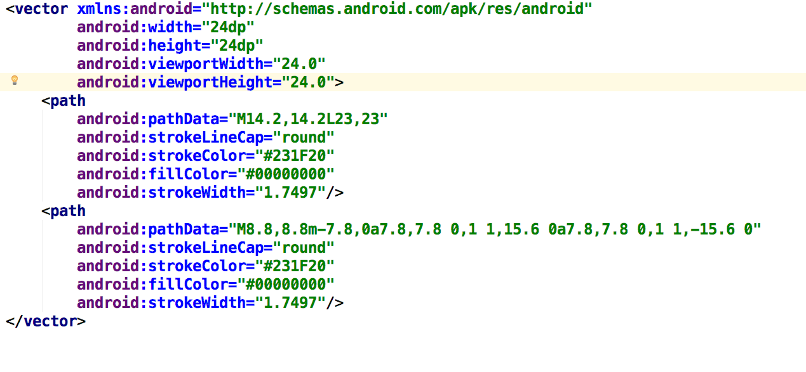
@loraj_k

Slide 43
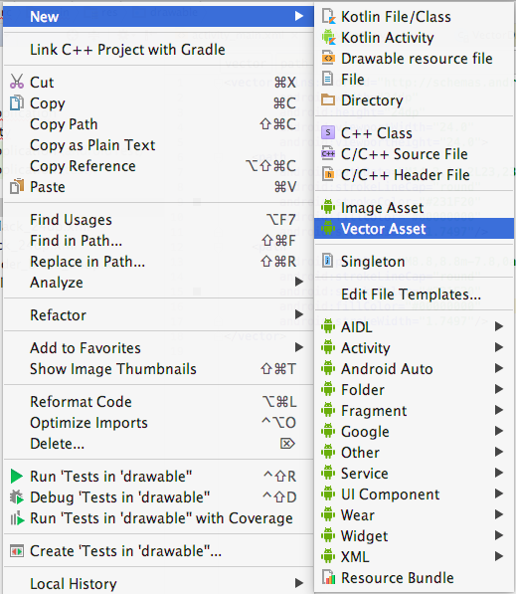
@loraj_k

Slide 44
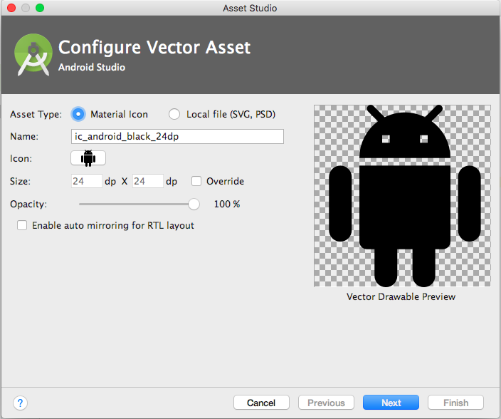
@loraj_k

Slide 45
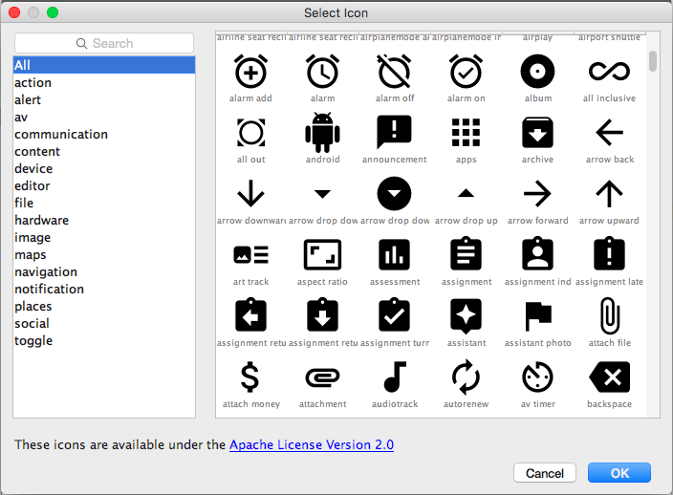
@loraj_k

Slide 46
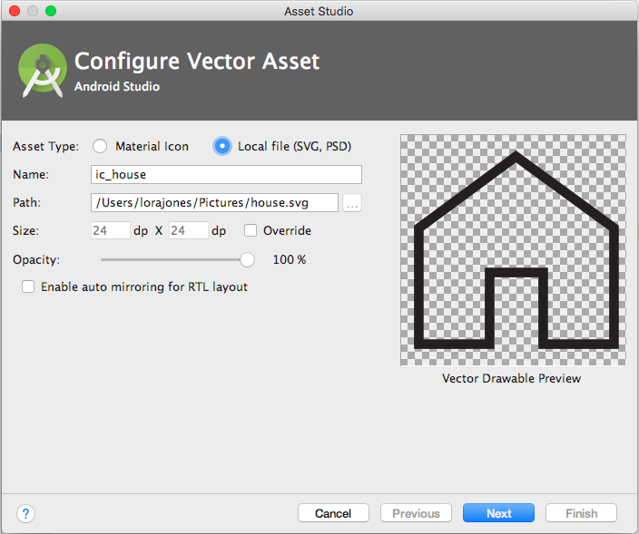
@loraj_k

Slide 47
@loraj_k

Slide 48
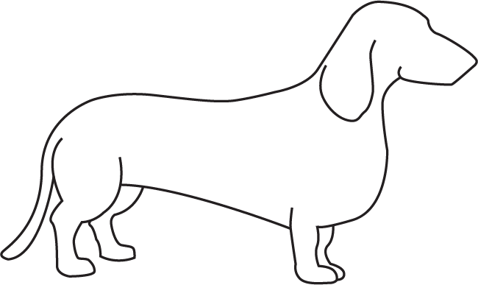
@loraj_k

Slide 49
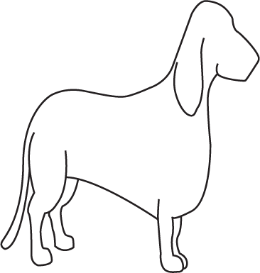
@loraj_k

Slide 50
@loraj_k

Slide 51
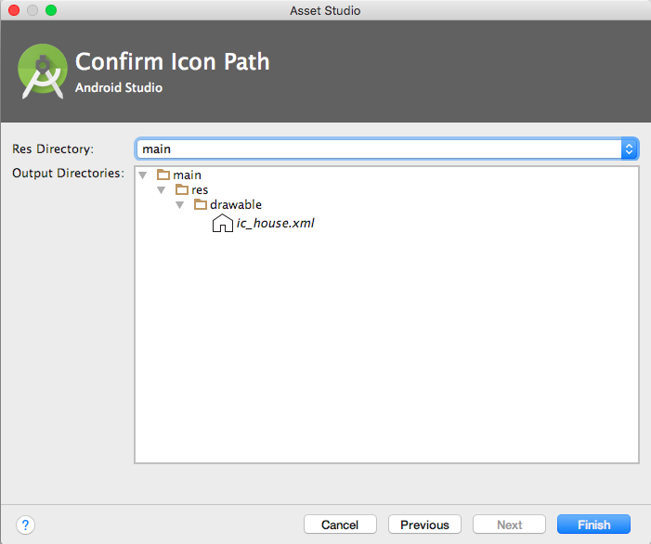
@loraj_k

Slide 52
<vector xmlns:android="http://schemas.android.com/apk/res/android"
android:width="24dp"
android:height="24dp"
android:viewportWidth="24.0"
android:viewportHeight="24.0">
<path
android:strokeWidth="1" android:pathData="M1.9,21.7l7.3,0l0,-7.4l5.6,0l0,7.4l7.3,0l0,-12l-10.1,-7.4l-10.1,7.4z"
android:strokeLineCap="round"
android:strokeColor="#231F20"
android:fillColor="#00000000"/>
</vector>
@loraj_k

Slide 53
And you said something about animations?
@loraj_k

Slide 54
@loraj_k

Slide 55
shapeshifter.design
@loraj_k

Slide 56
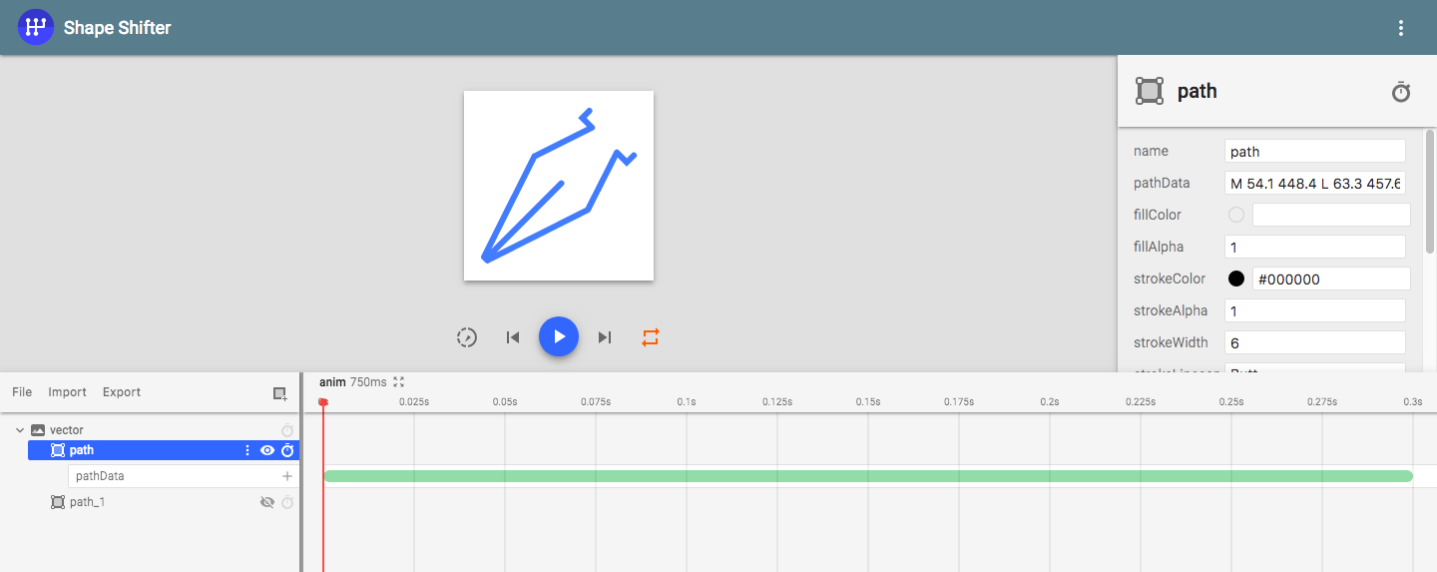
@loraj_k
Notes:
Things you can animate: fill color, fill alpha, stroke color, stroke alpha, stroke width, trim path from start, end, or offset

Slide 57
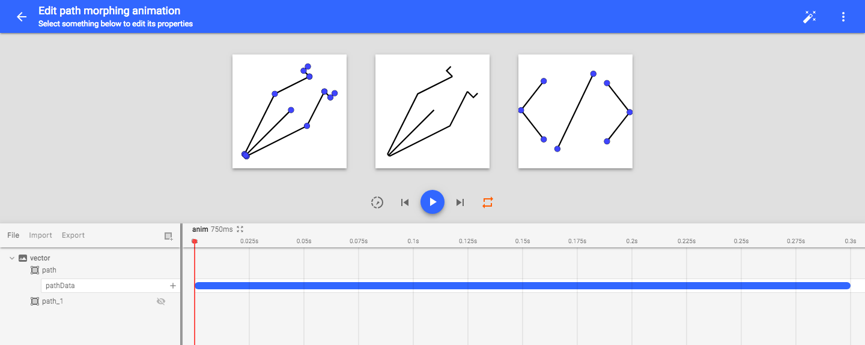
@loraj_k

Slide 58
@loraj_k

Slide 59
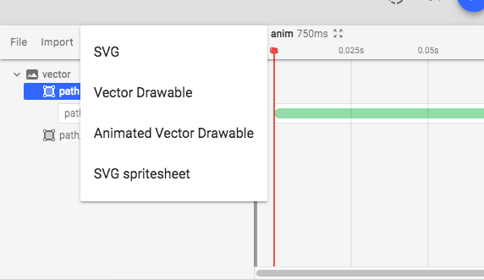
@loraj_k

Slide 60
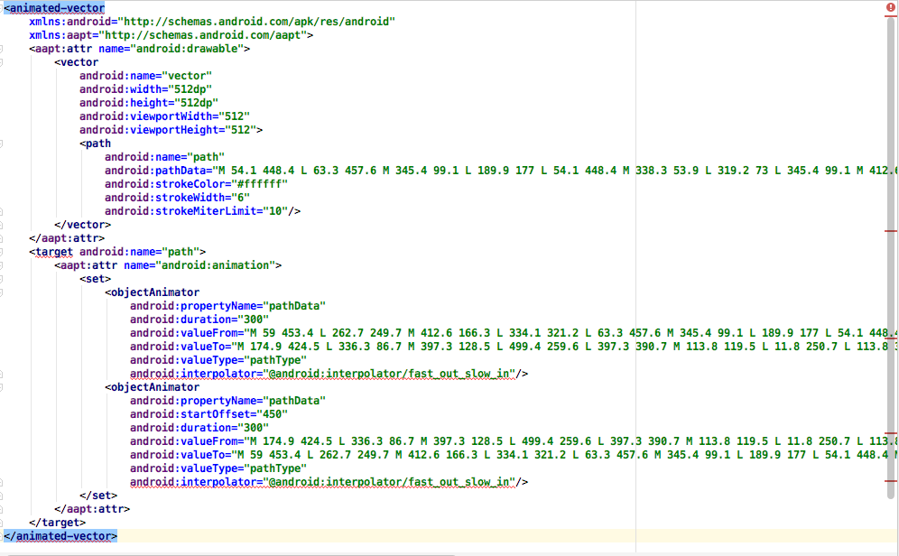
@loraj_k

Slide 61
Possible problems you may come across
@loraj_k

Slide 62
PERFORMANCE
@loraj_k

Slide 63
Courtesy of Giphy
@loraj_k

Slide 64
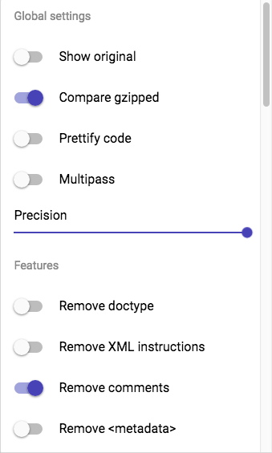
SVGO/SVGOMG
https://github.com/svg/svgo
https://jakearchibald.github.io/svgomg/
Optimize your SVGs by removing things like comments, metadata, empty containers, defaults
@loraj_k

Slide 65
CROPPING
@loraj_k

Slide 66
<vector xmlns:android="http://schemas.android.com/apk/res/android"
android:width="24dp"
android:height="24dp"
android:viewportWidth="24.0"
android:viewportHeight="24.0">
@loraj_k

Slide 67
<vector xmlns:android="http://schemas.android.com/apk/res/android"
android:width="24dp"
android:height="24dp"
android:viewportWidth="24.0"
android:viewportHeight="24.0">
@loraj_k

Slide 68
0,0
@loraj_k

Slide 69
@loraj_k

Slide 70
@loraj_k

Slide 71
@loraj_k

Slide 72
@loraj_k

Slide 73
FILL TYPE
@loraj_k

Slide 74
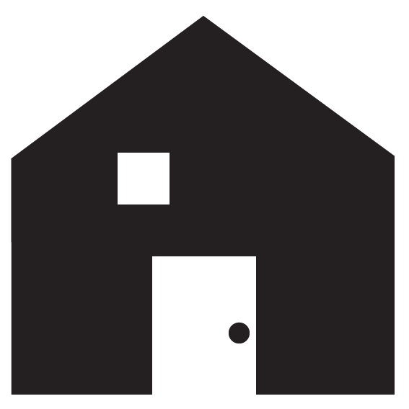
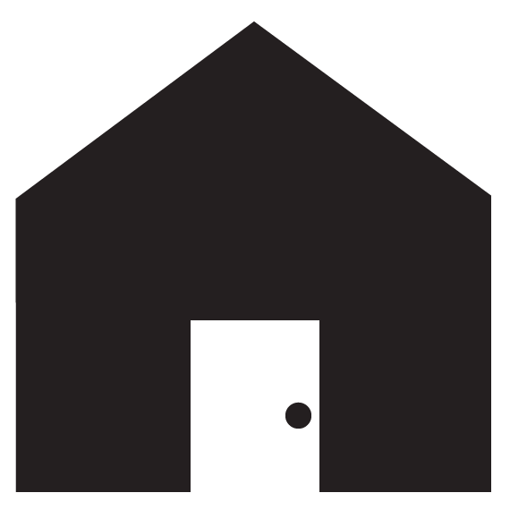
Asset
Displayed in app?
@loraj_k

Slide 75

@loraj_k

Slide 76
Fill Rules
@loraj_k

Slide 77
Fill Rules
nonzero
evenodd
(svg and android default)
(sketch default)
@loraj_k

Slide 78
Fill Rules - nonzero
@loraj_k

Slide 79
@loraj_k

Slide 80
@loraj_k

Slide 81
@loraj_k

Slide 82
@loraj_k

Slide 83
@loraj_k

Slide 84
Counter-clockwise
1 is subtracted when the ray crosses a path counter-clockwise
Result is zero - the inner path is outside of our house and displays as empty
+1
-1
@loraj_k

Slide 85
Clockwise
1 is added when the ray crosses a clockwise path
Result is 2 - the inner path is inside of our house and displays as filled
+1
+1
@loraj_k

Slide 86
Fill Rules - evenodd
@loraj_k

Slide 87
@loraj_k

Slide 88
Even
1 is added when the ray crosses a path, regardless of direction
Result is two - the inner path is outside of our house and displays as empty
+1
+1
@loraj_k

Slide 89
Odd
1 is added when the ray crosses a path
Result is 1 - the whole shape is filled
+1
@loraj_k

Slide 90
Fill Type
android:fillType=“evenOdd”
Supported API 24+
Convert using a converter that will correct fill-type to non-zero - located here
Talk to your designers
@loraj_k

Slide 91
Fill Type Resources
W3 - Fill Rules
Understanding Fill Rules
Exporting SVGs from Sketch
Styling Android - Fill Rules
@loraj_k

Slide 92
API SUPPORT
@loraj_k
Notes:
Vector drawable is 21+, gradients and fill types are 24+

Slide 93
More Resources:
W3 Documentation
W3 Schools Intro to SVG
Mozilla Docs - SVG
https://shapeshifter.design/
@loraj_k

Slide 94
Thanks!
Lora Kulm
@loraj_k
lorajk.com

